Slide 1
AZ-900T0x Module 06: Azure pricing and lifecycle
Notes:
Adjust the cover for either AZ-900T00 or AZ-900T01.
This content in SkillPipe is now aligned with the content in Learn. The notes section of the PPT will call out any free Learn sandbox exercises available and provide direct links that can be shared with students (if they are not able to create a free Azure account and/or are not following along in Learn).
https://docs.microsoft.com/en-us/learn/paths/az-900-describe-azure-cost-management-service-level-agreements/

Slide 2

Module Outline
Notes:
Learn and SkillPipe content order note:
Slides 1-5
https://docs.microsoft.com/en-us/learn/modules/plan-manage-azure-costs/1-introduction

Slide 3

Module 06 – Outline
You will learn the following concepts:
Methods for managing costs
Factors affecting costs
Options to reduce and control costs
Azure Cost Management
Service Level Agreements and Lifecycles
Azure Service Level Agreement (SLA)
Factors impacting SLAs
Azure product and feature lifecycle
Notes:
Learn and SkillPipe content order note:
Slides 1-5
https://docs.microsoft.com/en-us/learn/modules/plan-manage-azure-costs/1-introduction

Slide 4

Planning and Cost Management
Notes:
Learn and SkillPipe content order note:
Slides 1-5
https://docs.microsoft.com/en-us/learn/modules/plan-manage-azure-costs/1-introduction

Slide 5
Planning and Cost Management - Objective Domain
Identify factors that can affect costs (resource types, services, locations, ingress and egress traffic)
Identify factors that can reduce costs (reserved instances, reserved capacity, hybrid use benefit, and spot pricing)
Describe the functionality and usage of the Pricing calculator and the Total Cost of Ownership (TCO) calculator
Describe the functionality and usage of Azure Cost Management
Notes:
Learn and SkillPipe content order note:
Slides 1-5
https://docs.microsoft.com/en-us/learn/modules/plan-manage-azure-costs/1-introduction

Slide 6
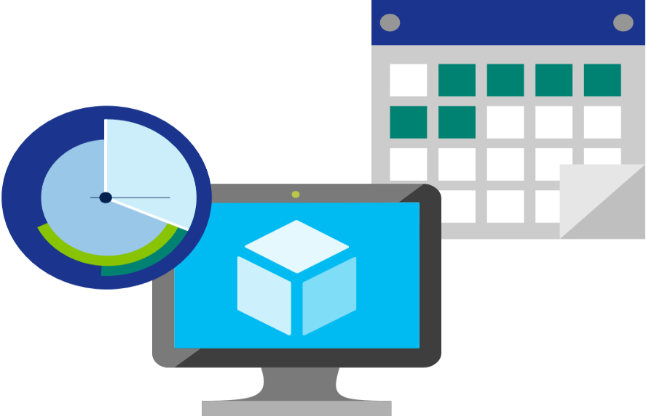
Factors affecting costs (part 1)
There are six primary factors affecting costs:
1) Resource Type | 2) Services | 3) Location
Costs are resource-specific, so the usage that a meter tracks and the number of meters associated with a resource, depend on the resource type. | Azure usage rates and billing periods can differ between Enterprise, Web Direct, and CSP customers. | The Azure infrastructure is globally distributed, and usage costs might vary between locations that offer Azure products, services, and resources.
Notes:
Azure usage charges - https://docs.microsoft.com/en-us/azure/billing/billing-understand-your-invoice
There are six primary factors affecting costs:
Resource Type: Costs are resource-specific, so the usage that a meter tracks and the number of meters associated with a resource depend on the resource type.
Services: Azure usage rates and billing periods can differ between Enterprise, Web Direct, and CSP customers.
Location: The Azure infrastructure is globally distributed, and usage costs might vary between locations that offer Azure products, services, and resources.
Learn and SkillPipe content order note:
Slides 6-8
https://docs.microsoft.com/en-us/learn/modules/plan-manage-azure-costs/4-purchase-azure-services

Slide 7
Factors affecting costs (part 2)
There are six primary factors affecting costs:
4) Bandwidth | 5) Reserved Instances | 6) Azure Hybrid Use Benefit
Some inbound data transfers are free, such as data going into Azure datacenters. For outbound data transfers, such as data going out of Azure datacenters, pricing is based on Zones. | With Azure Reservations, you commit to buying one-year or three-year plans for multiple products. Reservations can significantly reduce your resource costs up to 72% on pay-as-you-go prices. | For customers with Software Assurance, Azure Hybrid Benefit allows you to use your on-premises licenses on Azure at a reduced cost.
Notes:
Azure usage charges - https://docs.microsoft.com/en-us/azure/billing/billing-understand-your-invoice
https://docs.microsoft.com/en-us/azure/cost-management-billing/costs/cost-mgt-best-practices
There are six primary factors affecting costs:
Bandwidth: Some inbound data transfers are free, such as data going into Azure datacenters. For outbound data transfers, such as data going out of Azure datacenters, pricing is based on Zones.
Azure Reservations
Azure Reservations allow you to prepay for one-year or three-years of virtual machine or SQL Database compute capacity. Pre-paying will allow you to get a discount on the resources you use. Azure reservations can significantly reduce your virtual machine or SQL database compute costs — up to 72 percent on pay-as-you-go prices with one-year or three-year upfront commitment. Reservations provide a billing discount and don't affect the runtime state of your virtual machines or SQL databases.
For more information, see What are Azure Reservations?.
Use Azure Hybrid Benefit
If you already have Windows Server or SQL Server licenses in your on-premises deployments, you can use the Azure Hybrid Benefit program to save in Azure. With the Windows Server benefit, each license covers the cost of the OS (up to two virtual machines), and you only pay for base compute costs. You can use existing SQL Server licenses to save up to 55 percent on vCore-based SQL Database options. Options include SQL Server in Azure Virtual Machines and SQL Server Integration Services.
Learn and SkillPipe content order note:
Slides 6-8
https://docs.microsoft.com/en-us/learn/modules/plan-manage-azure-costs/4-purchase-azure-services

Slide 8
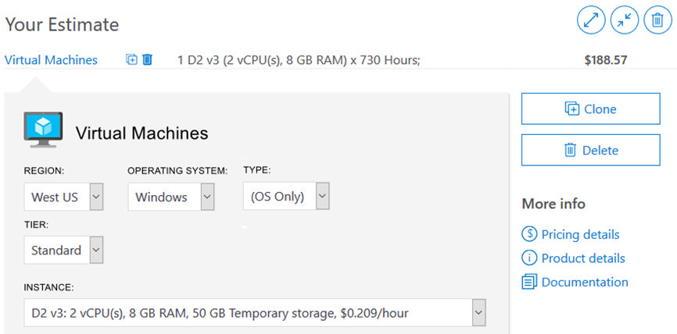
Pricing Calculator
The Pricing Calculator is a tool that helps you estimate the cost of Azure products. The options that you can configure in the Pricing Calculator vary between products, but basic configuration options include:
Region
Tier
Billing options
Support options
Programs and offers
Azure dev/test pricing
Notes:
Note: The pricing calculator provides estimates, and not actual price quotes. Actual prices can vary depending upon the date of purchase, the payment currency, and the type of Azure customer.
Learn and SkillPipe content order note:
Slides 6-8
https://docs.microsoft.com/en-us/learn/modules/plan-manage-azure-costs/4-purchase-azure-services

Slide 9
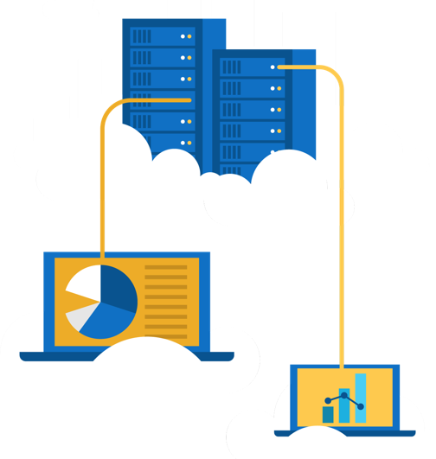
Walkthrough - Use the Azure Pricing Calculator
Use the Azure Pricing Calculator to generate a cost estimate for an Azure virtual machine and related network resources.
Configure the pricing calculator.
Review the pricing estimate.
Notes:
Learn has a non-sandbox exercise - Exercise - Estimate workload cost by using the Pricing calculator
https://docs.microsoft.com/en-us/learn/modules/plan-manage-azure-costs/5-estimate-workload-cost-pricing-calculator

Slide 10
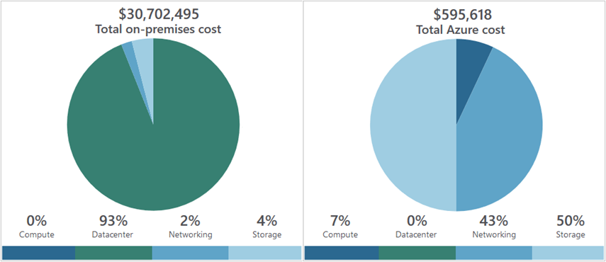
Total Cost of Ownership Calculator
A tool to estimate cost savings you can realize by migrating to Azure.
A report compares the costs of on-premises infrastructures with the costs of using Azure products and services in the cloud.
Notes:
TCO calculator - https://azure.microsoft.com/en-us/pricing/tco/calculator/
Learn and SkillPipe content order note:
https://docs.microsoft.com/en-us/learn/modules/plan-manage-azure-costs/2-compare-costs-tco-calculator

Slide 11
Walkthrough - Use the Azure TCO Calculator
Use the Total Cost of Ownership (TCO) Calculator to generate cost comparison report for an on-premises environment.
Configure the TCO calculator.
Review the results and save a copy.
Notes:
Learn has a non-sandbox exercise - Exercise - Compare sample workload costs by using the TCO Calculator
https://docs.microsoft.com/en-us/learn/modules/plan-manage-azure-costs/3-compare-workload-costs-tco-calculator

Slide 12
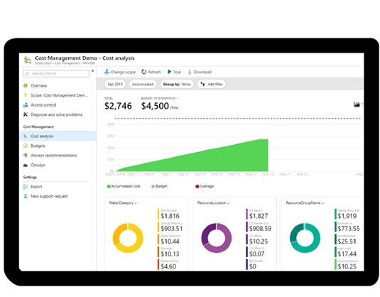
Azure Cost Management
Reporting – billing reports
Data enrichment
Budgets – set spend budget
Alerting – when cost exceed limits
Recommendation – cost recommendations
Notes:
Note: For more information about Cost Management, refer to https://azure.microsoft.com/en-us/services/cost-management/
Learn and SkillPipe content order note:
Slides 12-13
https://docs.microsoft.com/en-us/learn/modules/plan-manage-azure-costs/6-manage-minimize-total-cost

Slide 13
Minimizing costs
Perform
Perform cost analyses. Use the Azure Pricing and TCO calculators.
Monitor
Monitor usage with Azure Advisor. Implement recommendations.
Use
Use spending limits. Use via free trial customers and some credit-based Azure subscriptions.
Use
Use Azure Reservations and Azure Hybrid Benefit (HUB).
Choose
Choose low-cost locations and regions. If possible, use low-cost locations.
Keep
Keep up-to-date with the latest Azure customer and subscription offers.
Apply
Apply tags to identify cost owners. Identify usage owners with tags.
Notes:
Learn and SkillPipe content order note:
Slides 12-13
https://docs.microsoft.com/en-us/learn/modules/plan-manage-azure-costs/6-manage-minimize-total-cost

Slide 14

Azure SLAs and service lifecycles
Notes:
Learn and SkillPipe content order note:
Slides 14-15
https://docs.microsoft.com/en-us/learn/modules/choose-azure-services-sla-lifecycle/1-introduction

Slide 15
Azure SLAs and service lifecycles - Objective Domain
Describe the purpose of an Azure Service Level Agreement (SLA)
Identify actions that can impact an SLA (i.e. Availability Zones)
Describe the service lifecycle in Azure (Public Preview and General Availability)
Notes:
Learn and SkillPipe content order note:
Slides 14-15
https://docs.microsoft.com/en-us/learn/modules/choose-azure-services-sla-lifecycle/1-introduction

Slide 16
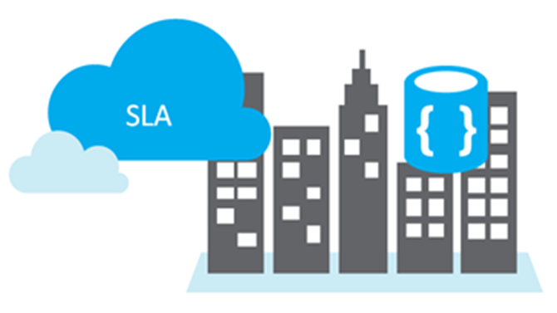
Service Level Agreements (SLAs)
Service Level Agreements (SLAs) describes Microsoft’s commitments for uptime and connectivity.
SLAs are based on individual products and services.
Detailed agreements on the service provided, and any exceptions to the SLA.
Free and preview features/services do not offer SLAs.
Notes:
SLA more information → https://docs.microsoft.com/en-us/office365/servicedescriptions/office-365-platform-service-description/service-level-agreement
SLAs define Microsoft’s commitment to an Azure service or product.
Individual SLAs are available for each Azure product and service.
SLAs also define what happens if a service or product fails to meet the designated availability commitments.
Learn and SkillPipe content order note:
Slides 16-17
https://docs.microsoft.com/en-us/learn/modules/choose-azure-services-sla-lifecycle/2-what-are-service-level-agreements
https://docs.microsoft.com/en-us/learn/modules/choose-azure-services-sla-lifecycle/3-define-application-sla

Slide 17
SLAs for Azure products and services
Performance targets are expressed as uptime and connectivity guarantees.
Performance-targets range from 99% to 99.999%.
If a service fails to meet the guarantees, a percentage of the monthly service fees can be credited.
SLA | Downtime per month
99% | 7h 18m 17s
99.5% | 3h 39m 8s
99.9% | 43m 49s
99.95% | 21m 54s
99.99% | 4m 22s
99.999% | 26s
Notes:
You might want to browse to some SLA’s directly https://azure.microsoft.com/en-us/support/legal/sla/summary/ and explore one or two as examples.
Performance targets are expressed as uptime and connectivity guarantees.
Performance-targets range from 99% to 99.999%.
If a service fails to meet the guarantees, a percentage of the monthly service fees can be credited
Not all services have an SLA
Learn and SkillPipe content order note:
Slides 16-17
https://docs.microsoft.com/en-us/learn/modules/choose-azure-services-sla-lifecycle/2-what-are-service-level-agreements
https://docs.microsoft.com/en-us/learn/modules/choose-azure-services-sla-lifecycle/3-define-application-sla

Slide 18
Actions that affect SLAs
Lower your SLA
Adding more services
Choosing free or non-SLA services
Raise your SLA
Availability Zones
Redundant systems
Many factors can raise or lower your SLA. Design decisions based on business goals will drive your SLA goals.
Notes:
Learn and SkillPipe content order note:
https://docs.microsoft.com/en-us/learn/modules/choose-azure-services-sla-lifecycle/4-design-application-meet-sla

Slide 19
Walkthrough - Calculate a Composite SLA
Determine services SLA uptime percentages and then calculate the application composite SLA uptime percentage.
Determine the SLA uptime percentage values for an application.
Calculate the Application Composite SLA percentage uptime.

Slide 20
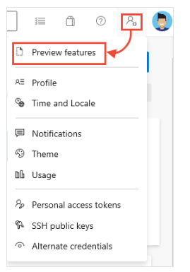
Azure Preview Program
With Azure previews, users can test beta and other pre-release features, products, services, software, and regions to provide feedback.
Public Preview: all Azure customers can evaluate the new features
Generally available (GA): after public preview is completed, all customers can use the feature, and region availability will vary.
Notes:
Some preview features are not covered by customer support.
For more information about Azure Previews, visit https://azure.microsoft.com/en-us/support/legal/preview-supplemental-terms/
Learn and SkillPipe content order note:
Slides 20-21
https://docs.microsoft.com/en-us/learn/modules/choose-azure-services-sla-lifecycle/5-access-preview-services

Slide 21
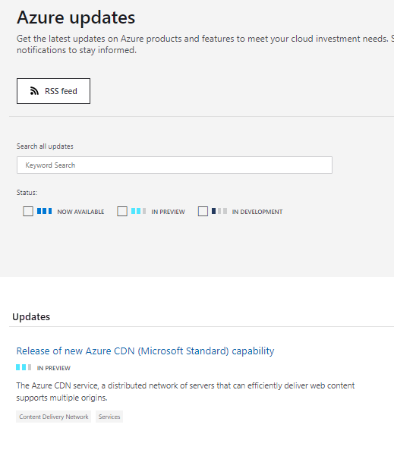
Monitoring service and feature updates
Azure updates provides information about the Azure products, services, and features, in addition to product roadmaps and availability.
View details about all Azure updates and their status.
Browse and search for updates.
Subscribe to Azure update notifications by RSS.
Notes:
For more information about Azure updates, refer to https://azure.microsoft.com/en-us/updates/
Learn and SkillPipe content order note:
Slides 20-21
https://docs.microsoft.com/en-us/learn/modules/choose-azure-services-sla-lifecycle/5-access-preview-services

Slide 22
Walkthrough - Access Azure Preview features
Access and identify Azure preview services and features and view the latest Azure updates information.
Access preview services and features.
Review the Azure updates page.

Slide 23

Knowledge Check
Which one?
A). Azure Portal
B). PowerShell
C). Local Tool
Populate with instructions to use the polling tool of your choice
Module 6
Use your Smartphones or Mobile Devices
Go to (insert polling app link of your choice)
Enter Code: 123-45-678
Please participate in the quiz for this section
Notes:
WWL recommends using polling to be completed for every 7 – 10 slides and preferably at the end of each section. This helps break classes up and adds more interactivity especially for remote classes.
In order to promote interactivity, WWL suggests the use of Mentimeter, Kahoot or a similar polling technology. Please feel free to adjust this slide as needed and populate with the instructions based on the polling tool of your choice.
Learn/SkillPipe note:
SkillPipe has a Module 6 review questions slide, while Learn has Knowledge checks individually through Learn modules that follow this PPT.
https://docs.microsoft.com/en-us/learn/modules/plan-manage-azure-costs/7-knowledge-check
https://docs.microsoft.com/en-us/learn/modules/choose-azure-services-sla-lifecycle/6-knowledge-check

Slide 24

Module 06 Review
Factors affecting costs
Recognize Azure Cost Management
Azure Service Level Agreement (SLA)
Factors impacting SLAs
Azure product and feature lifecycle
Microsoft Learn Modules (docs.microsoft.com/Learn)
Notes:
Learn/SkillPipe note:
SkillPipe has a Module 6 summary slide, while Learn has summary units individually through Learn modules that follow this PPT.
https://docs.microsoft.com/en-us/learn/modules/plan-manage-azure-costs/summary
https://docs.microsoft.com/en-us/learn/modules/choose-azure-services-sla-lifecycle/summary

